Slide 1


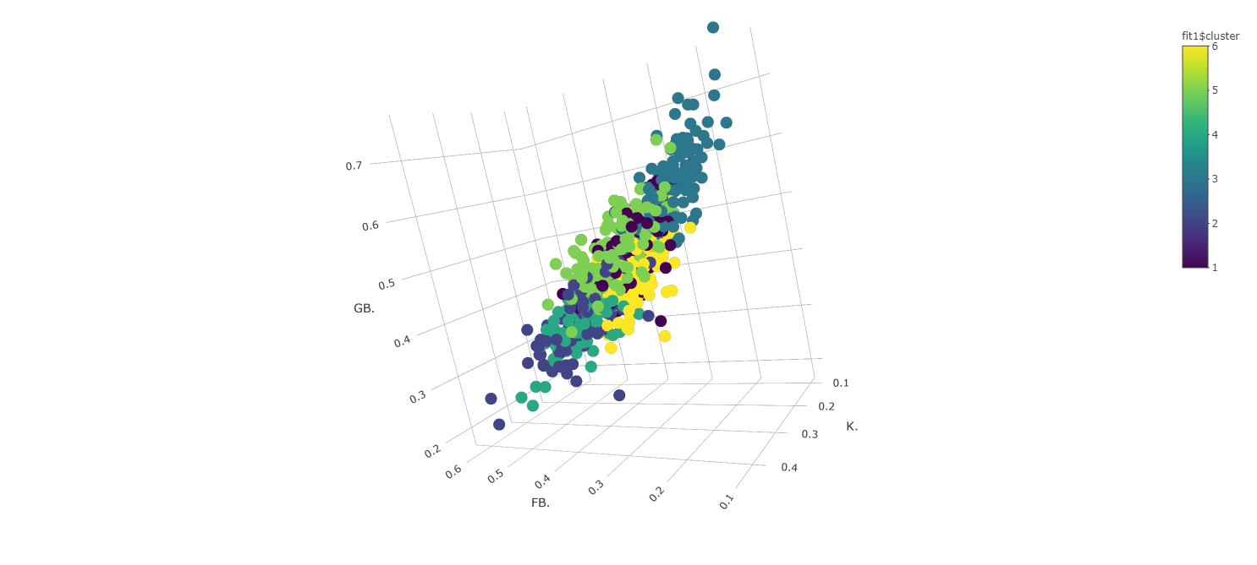
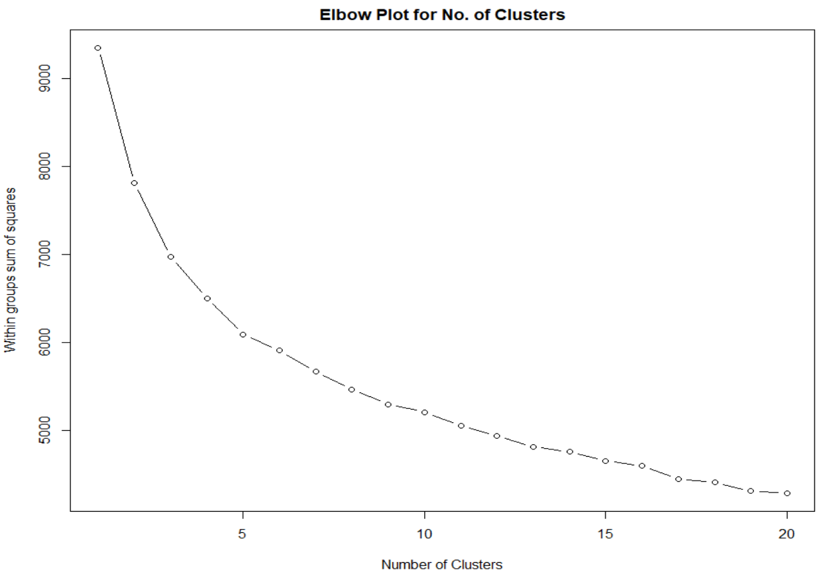
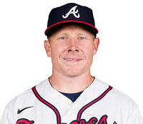


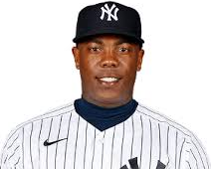
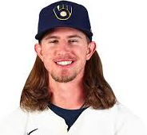

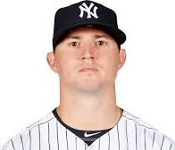
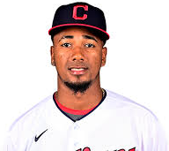
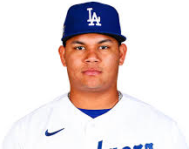



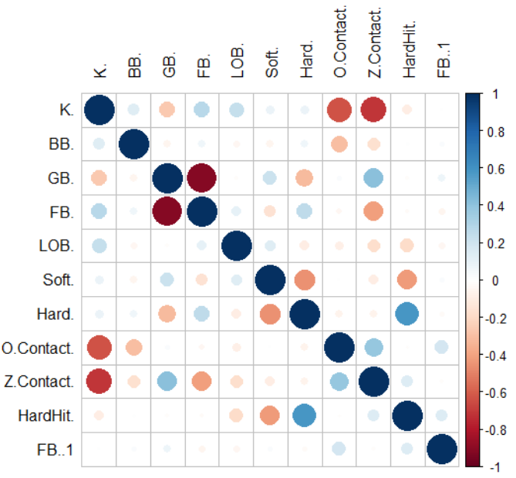

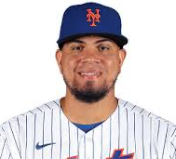

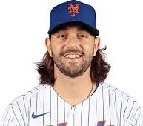

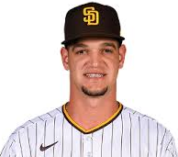
Reclassifying Relief Pitchers
By Dylan McGee - Department of Sport Analytics, Falk College of Sport and Human Dynamics, Syracuse University
dtmcgee@syr.edu | 315-882-6357 | www.linkedin.com/in/dmcgee20/
Background
Cluster Analysis Results
Since the creation of baseball, many rules set in place have stayed consistent with the current version of the game. These rules have been set for over 100 years with no scientific based theories to explain the reasoning behind them. One major rule that needs to be questioned is the utilization of the relief pitchers. Relief Pitchers have been classified under the following “roles:” Closers, Setup Men, Middle Relievers, Long Relievers, Left-Handed Specialists, and Openers. Once a player has a certain role for their team, they are expected to perform in those situations of the game. However, how can we determine who a true “closer” is? What makes a player fit this role? Typically, a team would assess all the relievers on their roster and assign roles based on standard statistics that have been around for years. What if, using a dataset with Standard, Advanced, Batted Ball and PFX data, we were able to cluster players based on their metrics? This way, we can reclassify relievers based on the groups they fit in compared to all the pitchers in the league, not just their team.
The results from the K-Means Cluster Analysis showed impressive results. The groups were able to form compact clusters that showed unique patterns within their statistics. Because of this, we can classify each cluster based off their metrics and use them in situations that suit their strengths. A 3D plot from three of the most important metrics in my analysis are shown with each pitcher plotted. As we can see, clusters are grouped together based off pitcher’s strengths and weaknesses. For example, Cluster 3 is in the top right of the graph, these pitcher’s have high GB%, low FB% and a slight below-average K% (we can’t see because of the screenshot of the graph). We later find out that this group is the groundball specialists of the data. On the contrary, cluster 6 sits about in the middle of all three metrics. After running averages, this group was by far the worst performing cluster with no strengths in anything. With that knowledge, we can use them in blowout games or if you need to rest other pitchers on your staff. This is also a great cluster to throw debuting pitchers.
Data/Methodology
Data was collected from FanGraphs. It includes only relief pitchers since the post-steroid era (2006-present) with a minimum of 20 innings pitched. The data was exported into excel where I was able to turn percentages into decimals and rearrange the order of the variables. From there, the dataset was imported into RStudio where I was able to start beginning to run correlations and cluster analysis. The variables used for analysis are below:
Statistic | Definition
K% (Strike Out %) | How often a pitcher gets strikeouts per plate appearance.
BB% (Walk %) | How often a pitcher gets walks per plate appearance.
GB% (Ground Ball %) | How often a pitcher gets ground balls per ball in play.
FB% (Fly Ball %) | How often a pitcher gets flyballs per ball in play.
LOB% (Left on Base %) | % of base runners that a pitcher strands on base.
Soft% (Soft Contact %) | % of soft-hit batted balls.
Hard% (Hard Contact %) | % of hard-hit batted balls.
O.Contact% (Outside of Zone Contact %) | How often contact is made outside of zone per swing outside of zone.
Z.Contact% (Inside of Zone Contact %) | How often contact is made inside of zone per swing inside of zone.
Hard Hit % (Hard Hit %) | % of hard-hit batted balls resulting the batter on-base.
FB1% (Fastball %) | % of fastballs compared to off-speed and breaking balls.
Conclusion
Cluster | Role | Usage | Notable Players
1 | Off-speed Specialists | Rely on off-speed to produce softer than average contact no matter the situation. Very reliable group. Use in almost any situation necessary. | Mark Melancon Sergio Romo Shane Greene
2 | Velo Specialists | By far highest velo average and usage rate. Excel in K’s but struggle with command at times. Use when looking for strikeouts or big velo change. | Aroldis Chapman Josh Hader Mychal Givens
3 | Groundball Specialists | Highest GB%, produce weakest contact but fewest K’s. Use when trying to limit long ball, keep the ball on the ground, or looking for double play. | Zack Britton Emmanuel Clase Brusdar Graterol
4 | Clutch Arms | Excel at getting outs with RISP. Above average in most categories. Use when in a close game situation, especially with RISP. | Roberto Osuna Nick Anderson Kirby Yates
5 | Strikeout Specialists | Have great off-speed which is used to get batters to chase outside of zone. Struggle with command occasionally but should be used when looking to limit contact at all costs. | Andrew Miller Dellin Betances Diego Castillo Adam Ottavino
6 | Under-developed | Worst group. Have the poorest numbers in most categories and don’t excel in anything. Use when out of options/up or down by a lot. | Robert Gsellman Ty Blach Michel Baez
The correlation didn’t show too many strong relationships. This is how I wanted to construct my data, that way each metric represented would tell its own story for each reliever. The only metrics kept which had strong relationships were ones I felt necessary to keep for accurate conclusions once the clusters were created.
Displayed above is an example of the Elbow Method which is used to determine the most effective amount of clusters for K-Means Cluster Analysis. The “elbow of the curve” is the cutoff point for mathematical optimization where diminishing returns are no longer worth additional cost. On this graph, that number would most likely be five. However, after multiple test results, I realized six groups was necessary for my project. Therefore, I concluded the best number of clusters to make was six.
We can see that there are 6 unique groups of pitchers who can be used in various situations throughout the course of a game. From here, we can use baseball simulation techniques and manage a team with our new method and compare the results with standard utilization techniques for relief pitchers. I believe by using K-Means Cluster Analysis, we can find insights on how to utilize pitching staffs more effectively and ultimately bring in more wins for your team. In the future, I plan on testing my cluster’s in real game situations as well as reconstruct reliever’s salary based on their cluster-importance.

